Slide 1

ABHAY KUMAR (REGISTRATION NUMBER: 42310001)

Slide 2
PROJECT TITLE:
HEART DISEASE PERDICATION USING MACHINE LEARNING IN PYTHON

Slide 3
Presentation Outline:
Abstract
Introduction
Domain
Literature Survey
Methodology
Application
Conclusion

Slide 4

Abstract:
Heart is one of the most important part of the body. It helps to purify and circulate blood to all parts of the body. Most number of deaths in the world are due to Heart Diseases. Some symptoms like chest pain, faster heartbeat, discomfort in breathing are recorded. This data is analyzed on regular basis. In this review, an overview of the heart disease and its current procedures is firstly introduced. Furthermore, an in-depth analysis of the most relevant machine learning techniques available on the literature for heart disease prediction is briefly elaborated. The discussed machine learning algorithms are Decision Tree, SVM, ANN, Naive Bayes, Random Forest, KNN. The algorithms are compared on the basis of features. We are working on the algorithm with best accuracy. This will help the doctors to assist the heart problem easily

Slide 5
Introduction:
Heart disease is the kind of disease which can cause the death. Each year too many peoples are dying due to heart disease. Heart disease can be occurred due to the weakening of heart muscle. Also, the heart failure can be described as the failure of heart to pump the blood. Heart disease is also called as coronary artery disease (CAD). CAD can be occurred due to insufficient blood supply to arteries. Heart disease can be detected using the symptoms like high blood pressure, chest pain, hypertension, cardiac arrest, etc. There are many types of heart diseases with different types of symptoms. Like: 1) heart disease in blood vessels: chest pain, shortness of breath, pain in neck throat., 2)heart disease caused by abnormal heartbeats :slow heartbeat, discomfort, chest pain., etc. Most common symptoms are chest pain, shortness of breath, discomfort, chest pain., etc. Most common symptoms are chest pain, shortness of breath, fainting. Causes of heart disease are defects you’re born with, high blood pressure, diabetes, smoking, drugs, alcohol. Sometimes in heart disease the infection also which affects the inner membrane which is identified by symptoms like fever, fatigue, dry cough, skin rashes. Causes of heart infection are bacteria, viruses, parasites. Types of heart disease: Cardiac arrest, Hypertension, Coronary artery disease, Heart failure, Heart infection, Congenital heart disease, Slow heartbeat, Stroke type heart disease, angina pectoris. Now a days there are too many automated techniques to detect the heart disease like data mining, machine learning, deep learning, etc. So, in this paper we will brief introduction about machine learning techniques. In this we train the datasets using the machine learning repositories. There are some risk factors on the basis of that the heart disease is predicted. Risk factors are Age, Sex, Blood pressure, Cholesterol level, Family history of coronary illness, Diabetes, Smoking, Alcohol, Being overweight, Heart rate, Chest Pain.

Slide 6
Different types of heart disease:
Arrhythmia | The heart beat is improper whether it may irregular, too slow or too fast.
Cardiac arrest | An unexpected loss of heart function, consciousness and breathing occur suddenly.
Congestive heart failure | The heart does not pump blood as well as it should, it is the condition of chronic.
Congenital heart disease | The heart’s abnormality which develops before birth.
Coronary artery disease | The heart’s major blood vessels can Damage or any disease occurs in the blood vessels
High Blood Pressure | It has a condition that the force of the blood against the artery walls is too high.
Peripheral artery disease | The narrowed blood vessels which reduce flow of blood in the limbs, is the circulatory condition.
Stroke | Interruption of blood supply occur damage to the brain.

Slide 7

Domain:
Machine Learning:
Machine Learning is the art and science of enabling machine to learn things Which are not explicitly programmed.
Python is Widely used general-purpose, high-level Programming Language.
Python Is a Programming Language that lets you work quickly and integrate Systems more efficiency.
Python Can be used Windows, Mac, Linux, etc.

Slide 8
Literature Survey:
YEAR | AUTHOR | PURPOSE | TECHNIQUES USED | ACCURACY
2015 | Sharma Purushottam et al,[15] | Efficient Heart Disease Prediction System using Decision Tree. | Decision tree classifie | 86.3% for testing phase. 87.3% for training phase
2015 | Boshra Brahmi et al, [20] | Prediction and Diagnosis of Heart Disease by Data Mining Techniques. | J48, Naïve Bayes, KNN, SMO | J48 gives better accuracy than other three technique
2015 | Sairabi H. Mujawar et al, [24] | Prediction of Heart Disease using Modified K-means and by using | Modified k-means algorithm, naive bayes algorithm. | Heart Disease detection=93%. Heart Disease
2015 | Noura Ajam et al, [21] | Heart Disease Diagnoses using Artificial Neural Network. | ANN | 88%
2016 | Prajakta Ghadge et al, [22] | Intelligent Heart Disease Prediction System using | Hadoop, Mahout, Naïve bayes. | The automation of this system makes extremely
2017 | P. Sai Chandrasekhar Reddy et al, [17] | Heart disease prediction using ANN algorithm in data mining. | ANN | Accuracy proved in JAVA.
2017 | Jayami Patel et al,[14] | Heart disease Prediction using Machine Learning and Data mining Technique. | LMT, UCI | UCI gives better accuracy, compared to LMT.
2018 | Chala Bayen et al,[12] | Prediction and Analysis the occurrence of Heart Disease using data mining techniques. | J48, Naïve Bayes, Support Vector Machine | It gives short time result which helps to give quality of services and reduce cost to individuals.
2018 | R. Sharmila et al, [13 | A conceptual method to enhance the prediction of heart diseases using the data techniques | VM in parallel fashion | SVM provides better and efficient accuracy of 85% and 82.35%. SVM in parallel fashion gives better accuracy than sequential SVM.

Slide 9
METHDOLOGY:
EXISTING SYSTEM:
Heart disease is even being highlighted as a silent killer which leads to the death of a person without obvious symptoms. The nature of the disease is the cause of growing anxiety about the disease & its consequences. Hence continued efforts are being done to predict the possibility of this deadly disease in prior. So that various tools & techniques are regularly being experimented with to suit the present-day health needs. Machine Learning techniques can be a boon in this regard. Even though heart disease can occur in different forms, there is a common set of core risk factors that influence whether someone will ultimately be at risk for heart disease or not. By collecting the data from various sources, classifying them under suitable headings & finally analyzing to extract the desired data we can conclude. This technique can be very well adapted to the do the prediction of heart disease. As the well-known quote says “Prevention is better than cure”, early prediction & its control can be helpful to prevent & decrease the death rates due to heart disease.

Slide 10
PROPOSED SYSTEM:
The working of the system starts with the collection of data and selecting the important attributes. Then the required data is preprocessed into the required format. The data is then divided into two parts training and testing data. The algorithms are applied and the model is trained using the training data. The accuracy of the system is obtained by testing the system using the testing data. This system is implemented using the following modules.
1.) Collection of Dataset
2.) Selection of attributes
3.) Data Pre-Processing
4.) Balancing of Data
5.) Disease Prediction

Slide 11
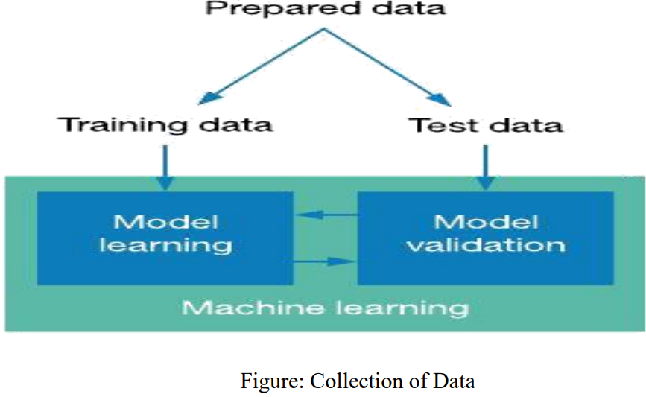
1 Collection of dataset:
Initially, we collect a dataset for our heart disease prediction system. After the collection of the dataset, we split the dataset into training data and testing data. The training dataset is used for prediction model learning and testing data is used for evaluating the prediction model. For this project, 70% of training data is used and 30% of data is used for testing. The dataset used for this project is Heart Disease UCI. The dataset consists of 76 attributes; out of which, 14 attributes are used for the system.

Slide 12
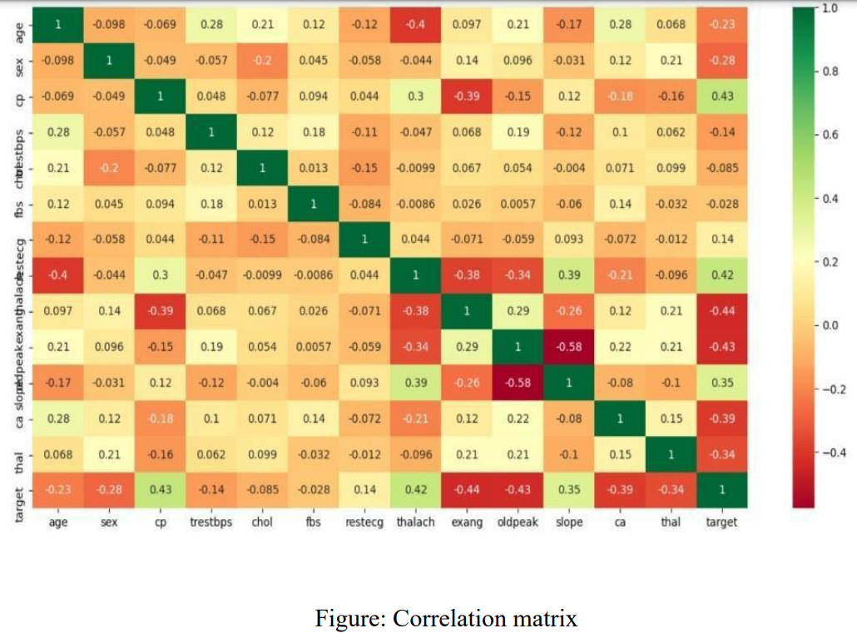
.2) Selection of attributes:
Attribute or Feature selection includes the selection of appropriate attributes for the prediction system. This is used to increase the efficiency of the system. Various attributes of the patient like gender, chest pain type, fasting blood pressure, serum cholesterol, exang, etc are selected for the prediction. The Correlation matrix is used for attribute selection for this model.

Slide 13
SELECTION OF THE ATTRIBUTES DATASET:
S.NO. | Attribute | Description | Type
1 | Age | Patient’s age (29 to 77) | Numerical
2 | Sex | Gender of patient(male-0 female-1) | Nominal
3 | Cp | Chest pain type | Nominal
4 | Trestbps | Resting blood pressure( in mm Hg on admission to hospital ,values from 94 to 200) | Numerical
5 | Chol | Serum cholesterol in mg/dl, values from 126 to 564) | Numerical
6 | Fbs | Fasting blood sugar>120 mg/dl, true- 1 false-0) | Nominal
7 | Resting | Resting electrocardio graphics result (0 to 1) | Nominal
8 | Thali | Maximum heart rate achieved(71 to 202) | Numerical
9 | Exang | Exercise included agina(1-yes 0- no) | Nominal
10 | Oldpeak | ST depression introduced by exercise relative to rest (0 to .2) | Numerical
11 | Slope | The slop of the peak exercise ST segment (0 to 1) | Nominal
12 | Ca | Number of major vessels (0-3) | Numerical
13 | Thal | 3-normal | Nomin

Slide 14
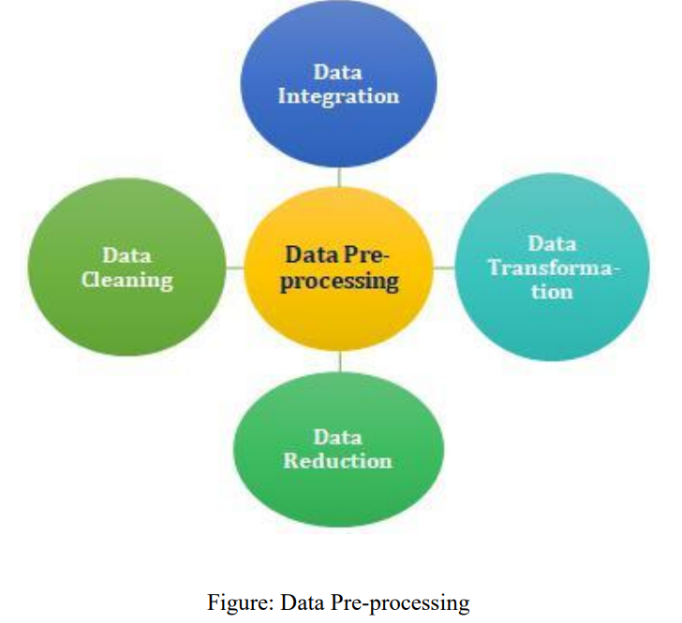
.3 )Pre-processing of Data:
Data pre-processing is an important step for the creation of a machine learning model. Initially, data may not be clean or in the required format for the model which can cause misleading outcomes. In pre-processing of data, we transform data into our required format. It is used to deal with noises, duplicates, and missing values of the dataset. Data pre-processing has the activities like importing datasets, splitting datasets, attribute scaling, etc. Preprocessing of data is required for improving the accuracy of the model.

Slide 15
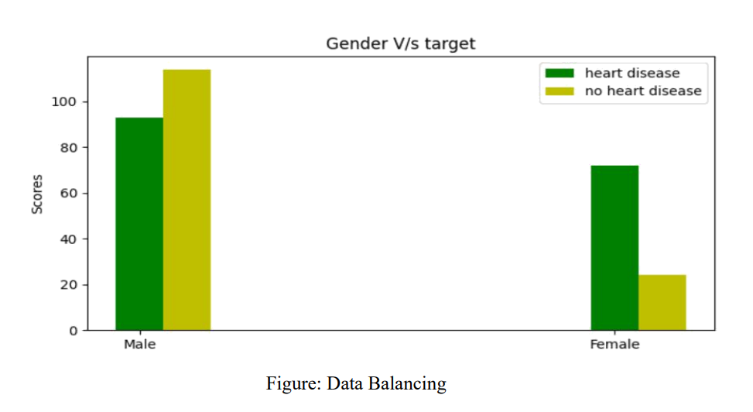
4) Balancing of Data:
Imbalanced datasets can be balanced in two ways. They are Under Sampling and Over Sampling
(a) Under Sampling: In Under Sampling, dataset balance is done by the reduction of the size of the ample class. This process is considered when the amount of data is adequate.
(b) Over Sampling: In Over Sampling, dataset balance is done by increasing the size of the scarce samples. This process is considered when the amount of data is inadequate.

Slide 16
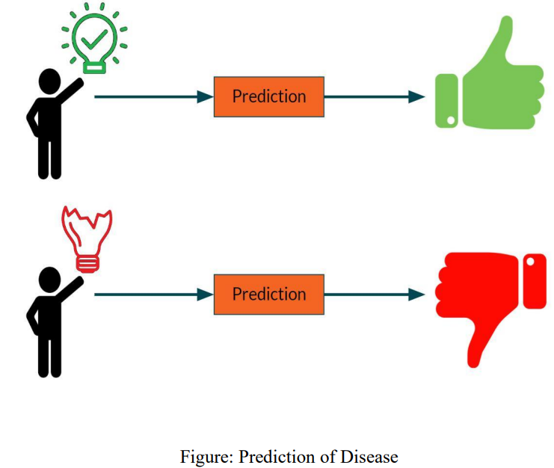
5) Prediction of Disease:
Various machine learning algorithms like SVM, Naive Bayes, Decision Tree, Random Tree, Logistic Regression, Ada-boost, Xg-boost are used for classification. Comparative analysis is performed among algorithms and the algorithm that gives the highest accuracy is used for heart disease prediction.

Slide 17
APPLICATION:
It utilizes the Data such as blood pressure, cholesterol, diabetes and then tries to predict the possible heart disease in patients (future Predication by diagnosis).
This may help in talking Preventive measure and hence can try to avoid the possibility of heart disease in patient.
So, When a patient is predicated as positive for heart disease, then the medical data for the patient can be analyzed by the doctors

Slide 18
Conclusion:
We have summarized different types of machine learning algorithms for prediction of heart disease. We elaborated various machine learning algorithms and worked towards finding the best algorithm by analyzing their features. Every algorithm has given different result in different situations. Further it is analyzed only marginal accuracy is achieved for predictive model of heart disease and hence more complex models are needed to increase the accuracy of predicting the early heart disease. In future we will propose methodology for early prediction of heart disease with high accuracy and minimum cost and complexity.

